Slide 1
Technology transfer proposal BSBF2024
Call for partnership, knowledge and technology transfer
VECTOR - Nuclear Fusion Engine for Rocket Propulsion
A Revolutionary Fusion Propulsion System for Space Exploration

Slide 2
TECHNOLOGY OVERVIEW
Call for partnership, knowledge and technology transfer
VECTOR Engine
The VECTOR Engine uses advanced fusion technology to provide efficient propulsion for deep space missions.
The VECTOR Engine integrates Magneto-Inertial Confinement (MIC) with Inertial Confinement Fusion (ICF) to achieve fusion, providing both energy generation and propulsion capabilities.
This system enhances propulsion efficiency using Hall Effect Thrusters (HET) and is suitable for deep space missions due to its dual functionality as an energy generator and propulsion system.

Slide 3
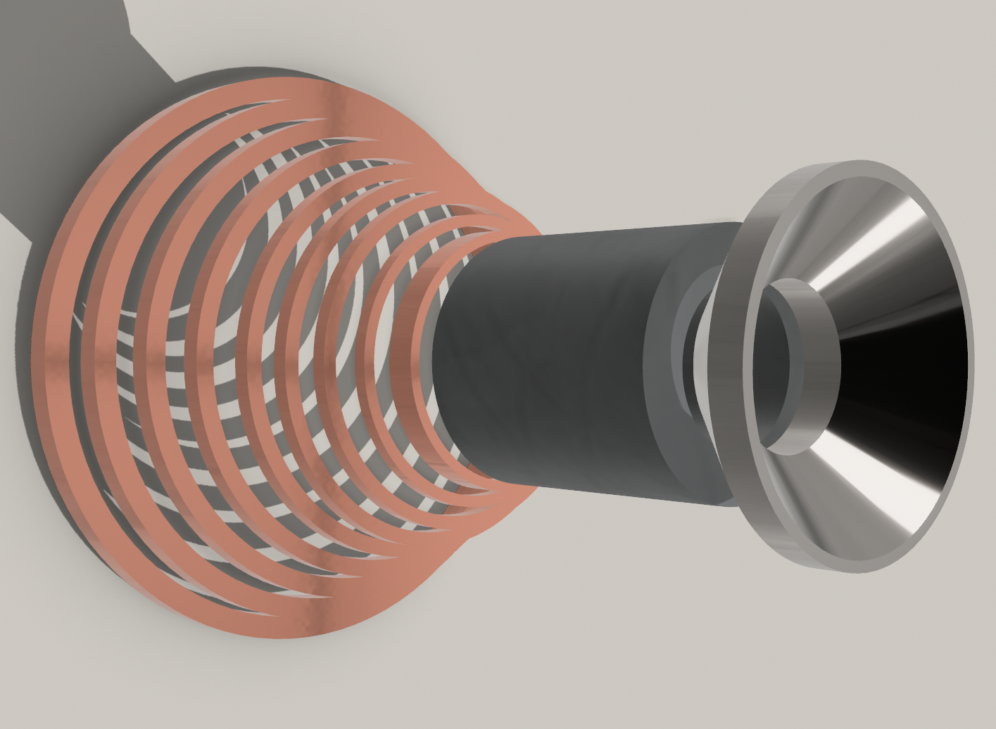
Technology transfer proposal BSBF2024
Call for partnership, knowledge and technology transfer
Benefits of the technology:
High Energy Efficiency: Minimal fuel requirement
Safety Advantages: Minimal radioactive waste
Scalability and Versatility: From small probes to large crewed ships.
Continuous Operation Capability: Allowing for maneuvers and adjustments throughout the mission duration.
Cost-Effectiveness
Lower Lifetime Costs :The high efficiency and reduced fuel needs.
Reusability across multiple missions
For more information contact: technologytransfer@f4e.europa.eu

Slide 4
Technology transfer proposal BSBF2024
Call for partnership, knowledge and technology transfer
What kind of partners we are looking for?
Aerospace Companies and Space Agencies specializing in propulsion systems and deep space missions.
Space Propulsion Systems (Specifically Ion Propulsion Systems made by agencies like the ESA)
Plasma Modelling & Diagnostics
Superconductors, MIC, ICF
Laser research facilities
RF cavity resonance, RF heating
Material Research for Space & Fusion
Plasma Experts, Material Experts, Propulsion Experts
VECTOR - Nuclear Fusion Engine for Rocket Propulsion (TRL 2-3 )
For more information contact: technologytransfer@f4e.europa.eu

Slide 5
Technology transfer proposal BSBF2024
Call for partnership, knowledge and technology transfer
VECTOR - efficiencies unmatched by other engines
Much Faster Mission Times: The higher thrust capabilities of VECTOR shorten travel times to distant destinations.
Versatile Fuel Handling: VECTOR's use of fusion fuel offers a broader potential for in-situ resource utilization compared to the specialized propellants required for other types of engines.
Direct Energy Conversion: VECTOR’s ability to more effectively convert fusion energy into electrical power and thrust via integrated systems like Hall Effect Thrusters offers a practical advantage in energy utilization over other fusion concepts which may rely solely on thermal conversion processes.
Non-Neutronic Fusion: VECTOR’s pB11 fusion minimizes this issue, simplifying the engine and spacecraft design.
VECTOR - Nuclear Fusion Engine for Rocket Propulsion (TRL 2-3 )
For more information contact: technologytransfer@f4e.europa.eu

