Slide 1

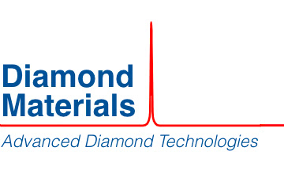

Technology transfer proposal BSBF2024
Call for partnership, knowledge and technology transfer
Innovative material to outperform natural diamond properties
Diamond materials is specialised in manufacturing diamond discs with better properties than natural diamond (low absorption, hardness, extremely high thermal conductivity, broad band optical transparency, chemical inertness). Based on a CVD process at 800ºC, the company can produce diamond in plates up to 150 mm in diameter and 2000 µm in thickness.

Slide 2

Technology transfer proposal BSBF2024
Call for partnership, knowledge and technology transfer
Benefits of the technology:
Outperforms natural diamond properties.
Natural diamond not available in the form of large disks
Application Areas:
High power windows (X-ray / lasers / microwaves)
X-ray anodes
UHV windows for beamlines
Fluorescence screens for Synchrotrons
Beam splitters for FTIR Spectrometers in outer space
contact@diamondmaterials.de
technologytransfer@f4e.europa.eu
For more information contact:

