Slide 1


Technology transfer proposal BSBF2024
Call for partnership, knowledge and technology transfer
Radio frequency (RF) discharge technology for remote optics cleaning in harsh environments.
The University of Basel has developed an innovative RF discharge technology to clean optical systems in harsh environments. The team has optimized radio frequency plasma cleaning parameters based on optics geometry, RF power, and coating type, using optical emission spectroscopy to gauge cleanliness and signal when cleaning is complete. This method preserves the longevity of optics, enhances cleaning efficiency and energy conservation.

Slide 2

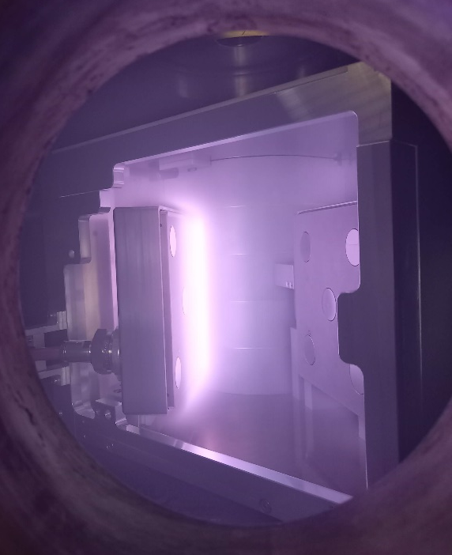
Technology transfer proposal BSBF2024
Call for partnership, knowledge and technology transfer
Benefits of the technology:
Enhanced Optical Longevity
Optimization of Cleaning Parameters, performing homogenous cleaning and being energy efficient.
Allows real-time monitoring.
Application Areas:
Space propulsion
Industrial plasma processes
Furnaces
Electronics
Biomedical
For more information contact: technologytransfer@f4e.europa.eu

