Slide 1
Technology transfer proposal BSBF2024
Call for partnership, knowledge and technology transfer
Company logo
Glass to Metal Seals for hermetic interconnexions
VAC-TRON has developed hermetic glass-to-metal seals that allow the hermetic passage of signals produced by multiple sensors. This interconnection system has high resistance to temperature (work range between -195°C to 300°C) and pressure (up to 2500 bar), offering safe and compact designs. The technology allows the sealing of different types of conductors on a single wall.

Slide 2
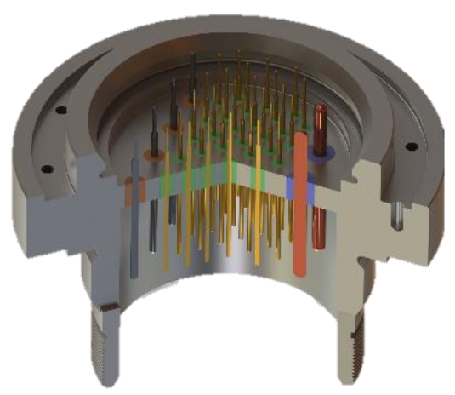
Technology transfer proposal BSBF2024
Call for partnership, knowledge and technology transfer
Benefits of the technology:
Hermetic interconnections at harsh environments.
Compact and simple designs.
Connection of different types of conductors on a single wall.
Application Areas:
Bis Science facilities.
Aerospace.
Energy.
For more information contact: technologytransfer@f4e.europa.eu

