Slide 1
SORINTEX The first textile cluster in the Republic of Moldova

Slide 2
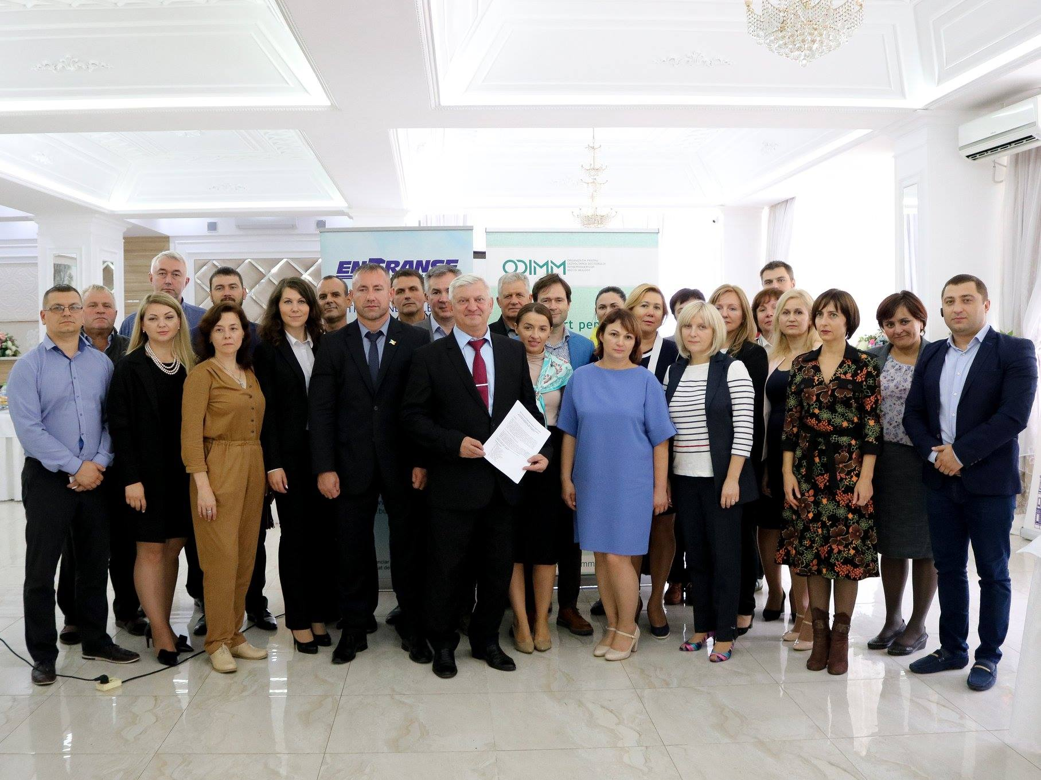
Cluster creation history «SORINTEX»
The "Sorintex" cluster from Republic of Moldova was created and organized with the support of several actors;
The agreement was signed on 11.09.2018.

Slide 3
Signing of the Protocol/Agreement on the establishment of a regional cluster in light industry "SORINTEX"
28 light industry enterprises: clothing, suppliers of raw materials, accessories, machinery, embroidery services, laundry, printing.
State authorities: Soroca District Council, Entrepreneurship Development Organization, National Employment Agency, North Regional Development Agency.
Education, research and innovation: Technical University of Moldova, Cooperative Commercial University of Moldova, Soroca Professional School, Drochia Professional School, Training Center, Balti Light Industry College.
Catalyst and consulting organizations: ProEntranse Consulting Agency, Soroca Business Incubator.

Slide 4
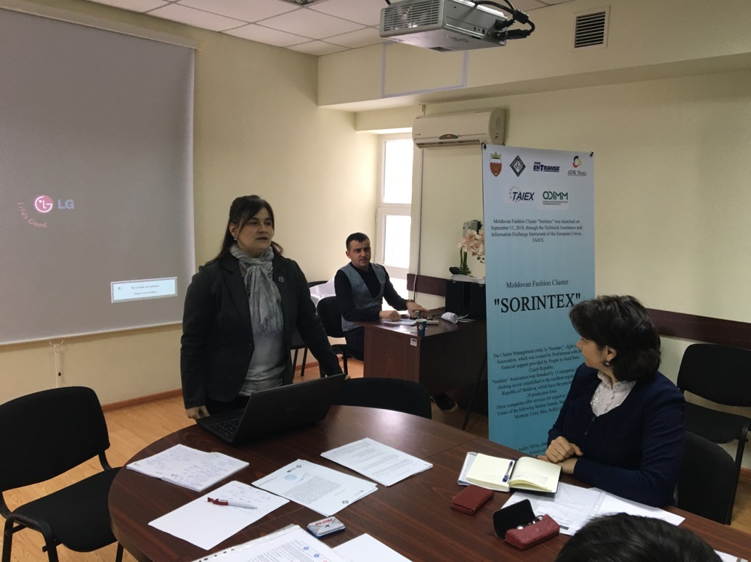
Legal support for the initial phase of registration of the Association "Sorintex" - the management entity of the Cluster through the activities in Techno Textile HUB (TTH) Soroca.
1. Training with the participation of the legal expert "ProEntranse" (October 2018); 2. Internships and training offered by the TTH center (January 2019);

Slide 5
The purpose of creating the SORINTEX cluster
Our goal was to create a broad partnership to support clothing and textile companies;
economic development tool, to initiate innovation, competitiveness and new business models for companies;
for increasing the competitiveness of enterprises;
research and development capabilities for members;
access to new markets;
access to financing opportunities;
Ensuring financial sustainability by connecting to international platforms.

Slide 6
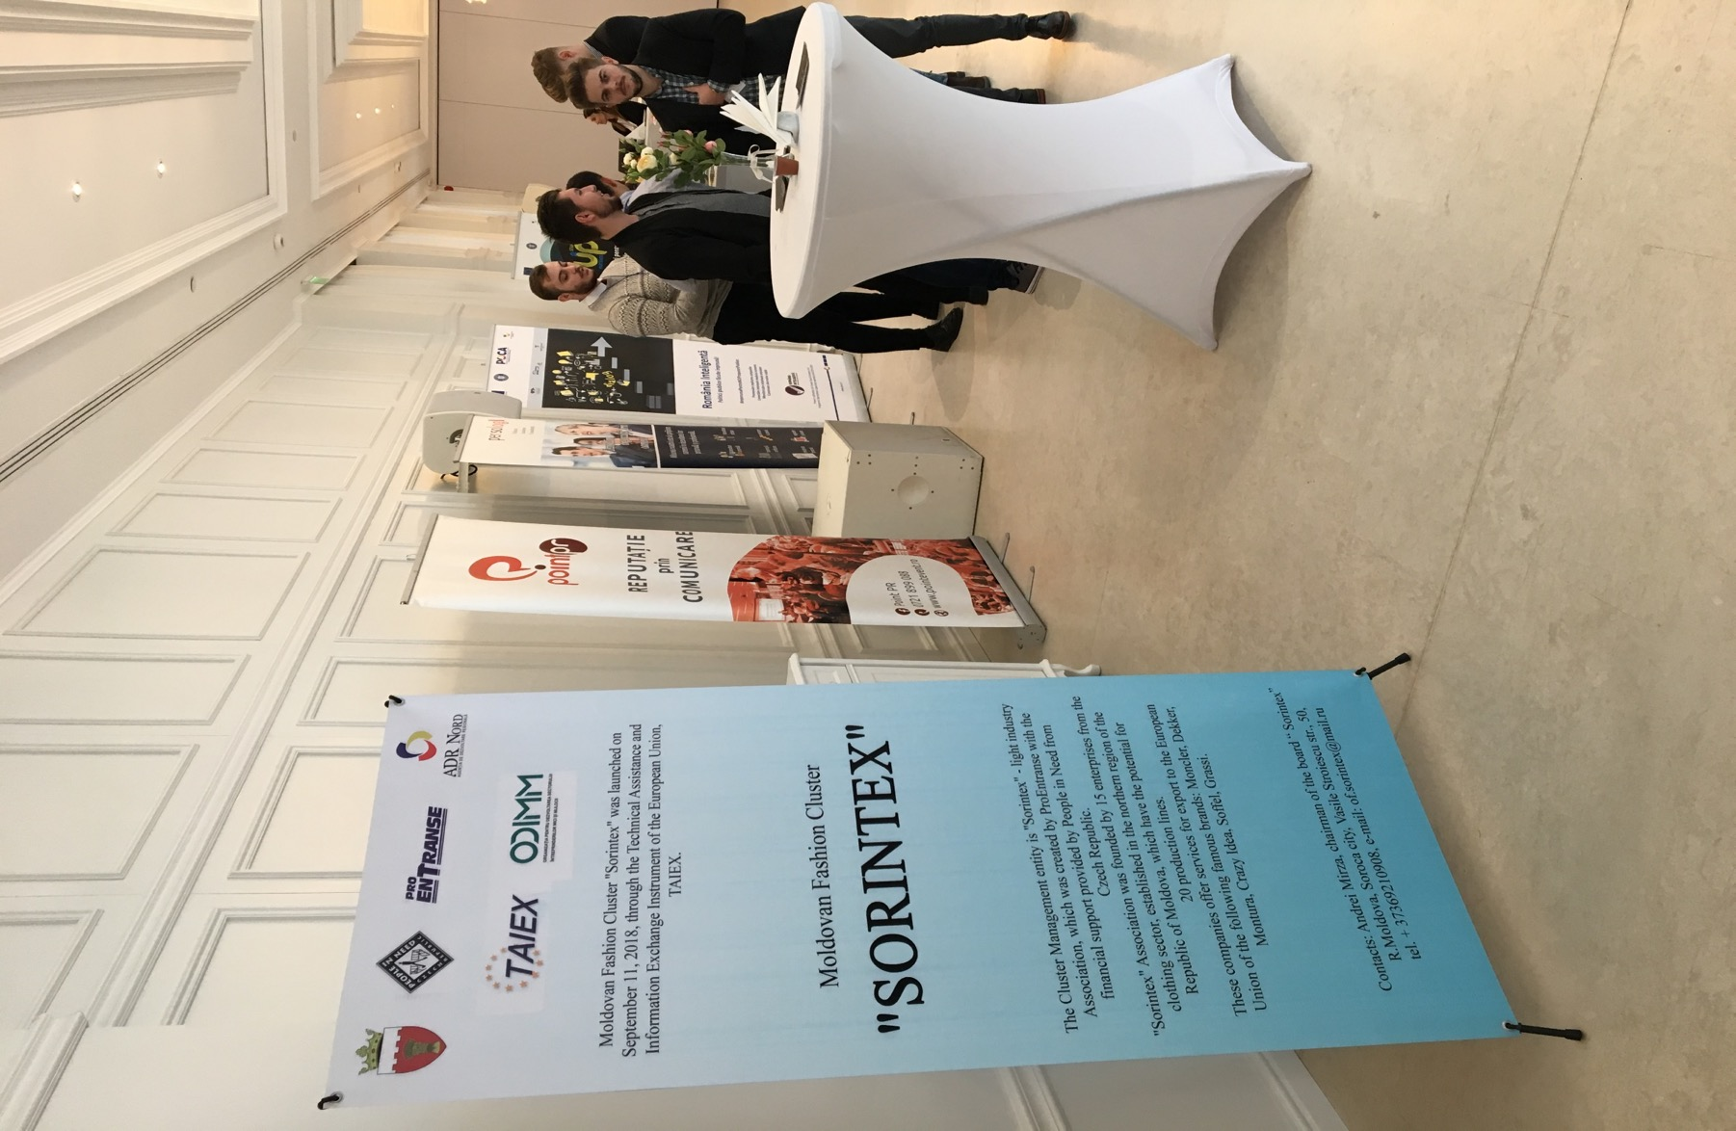
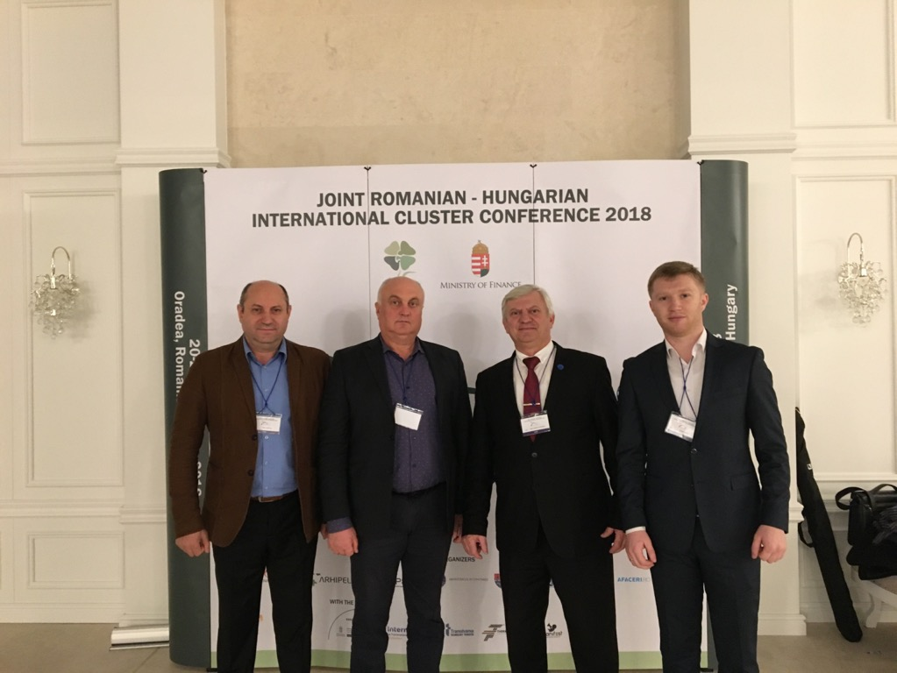
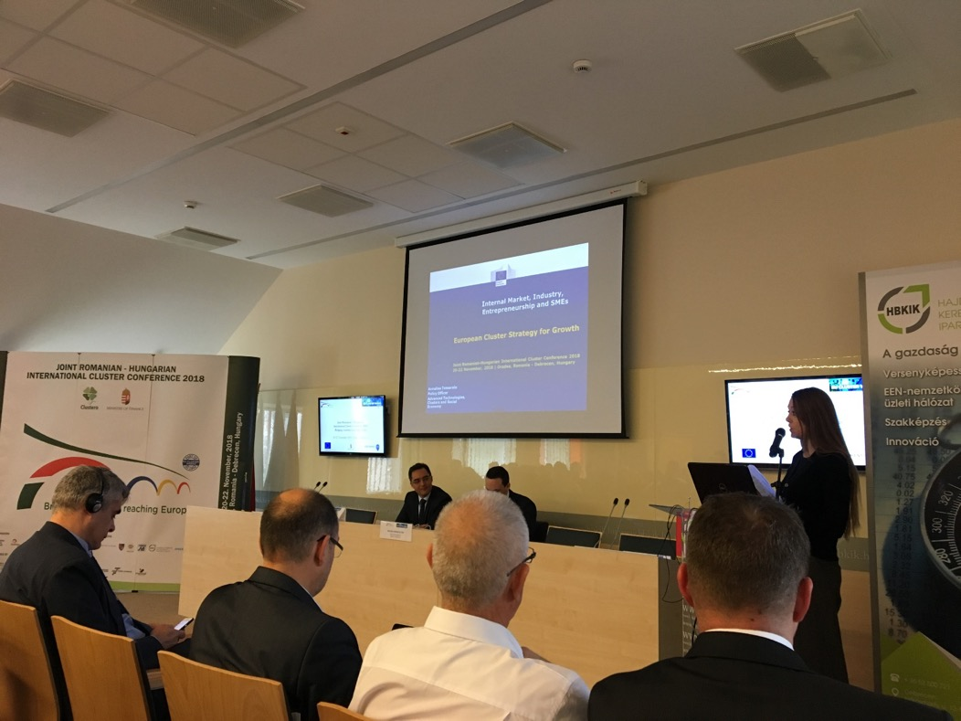
Participation in the Romanian-Hungarian Oragea-Debrecen international conference on 20-22.11.2018.

Slide 7
Exchange of experience with other clusters.
Astrico North-EastPiatra Neamt, Romania
Romanian Textile AssociationConcept, Bucharest.

Slide 8
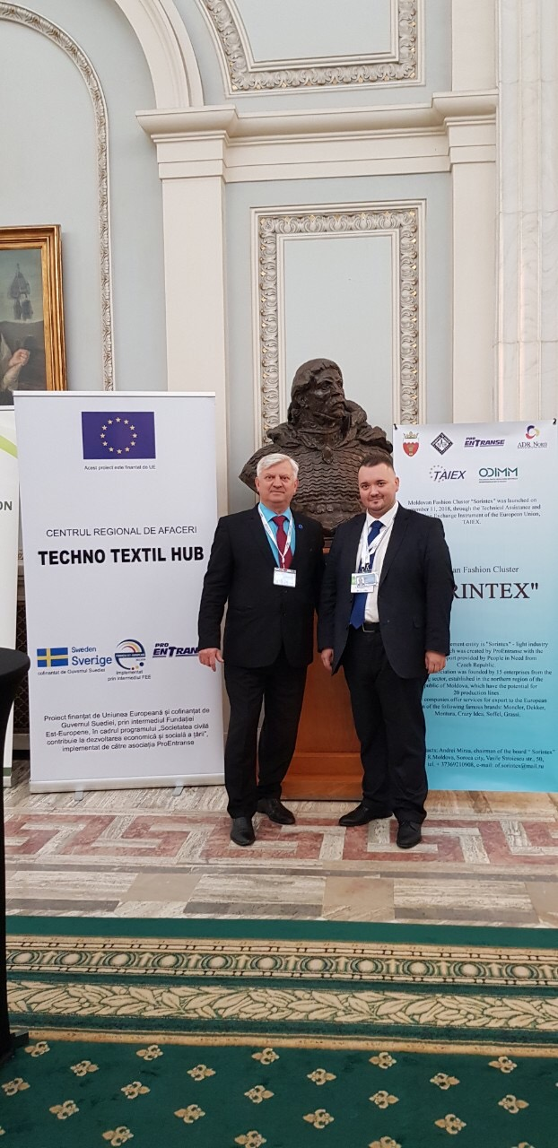
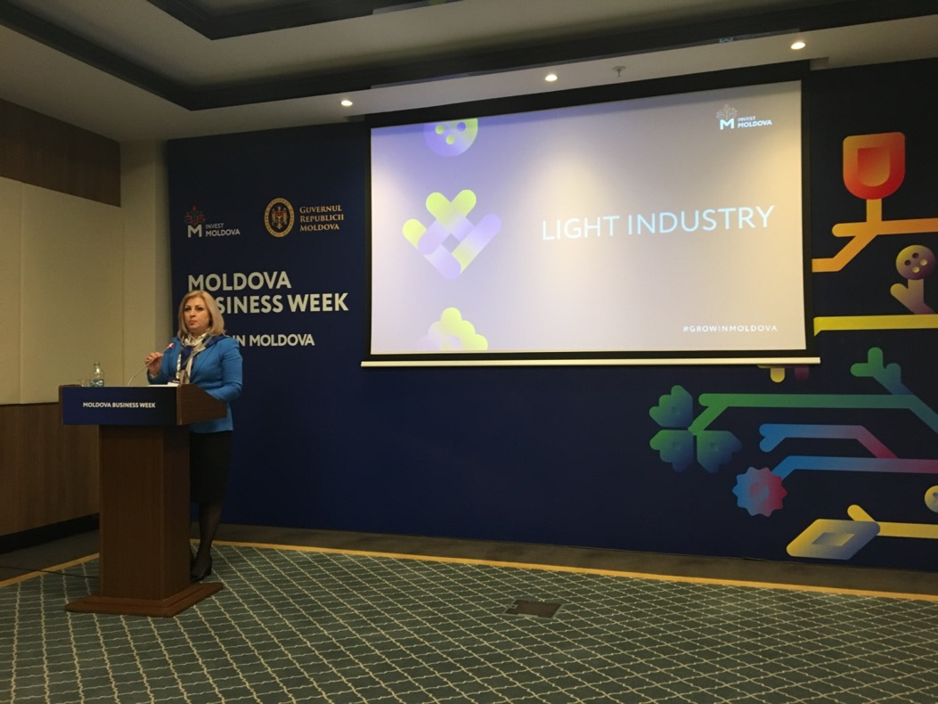
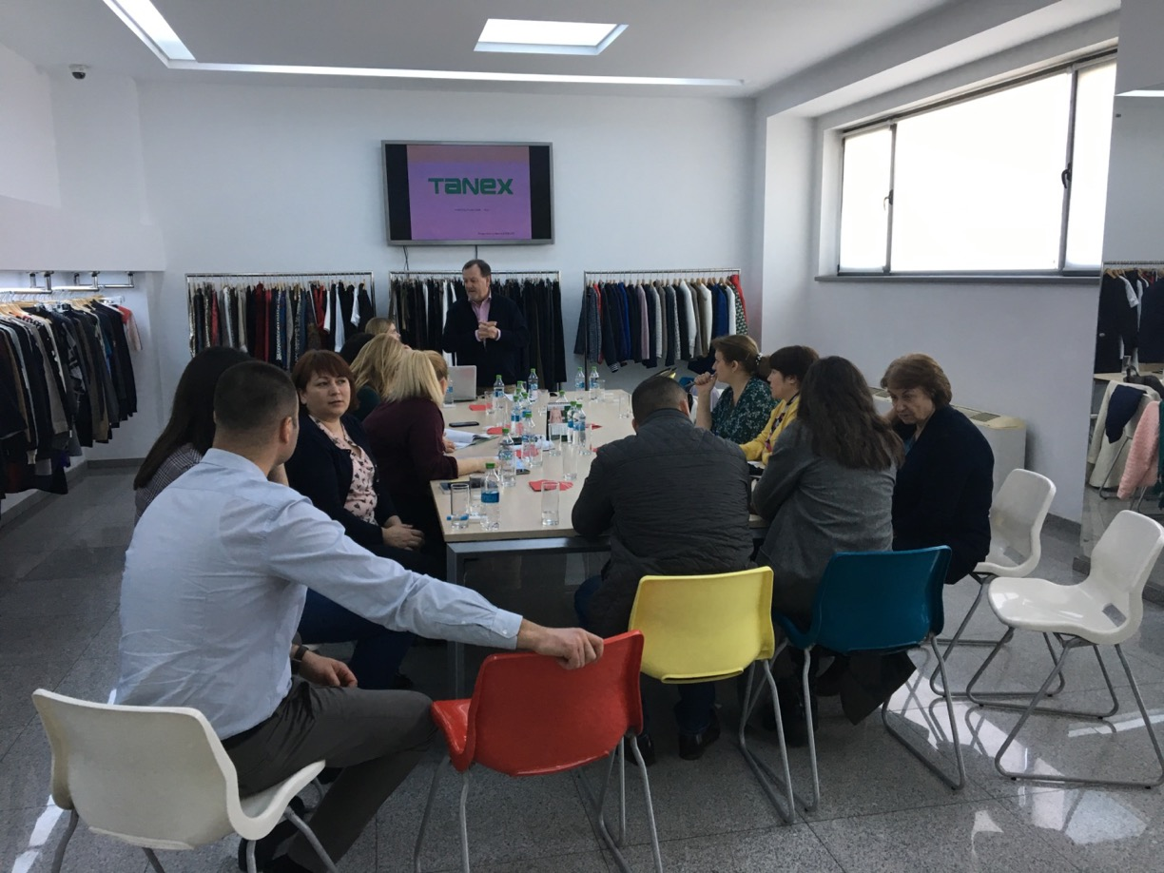
Promotion of the cluster at national and international level.
Tanex Bucuresti
Business Weak 2018
European Conference of Bucharest clusters

Slide 9
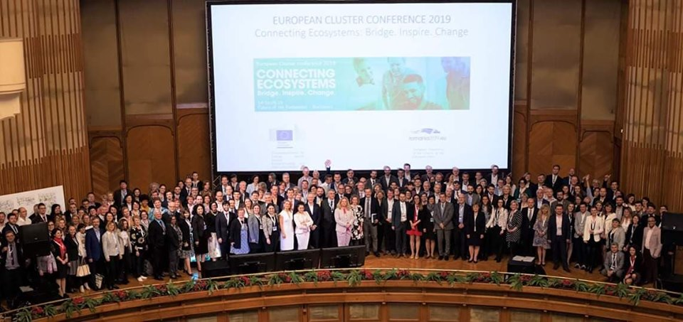
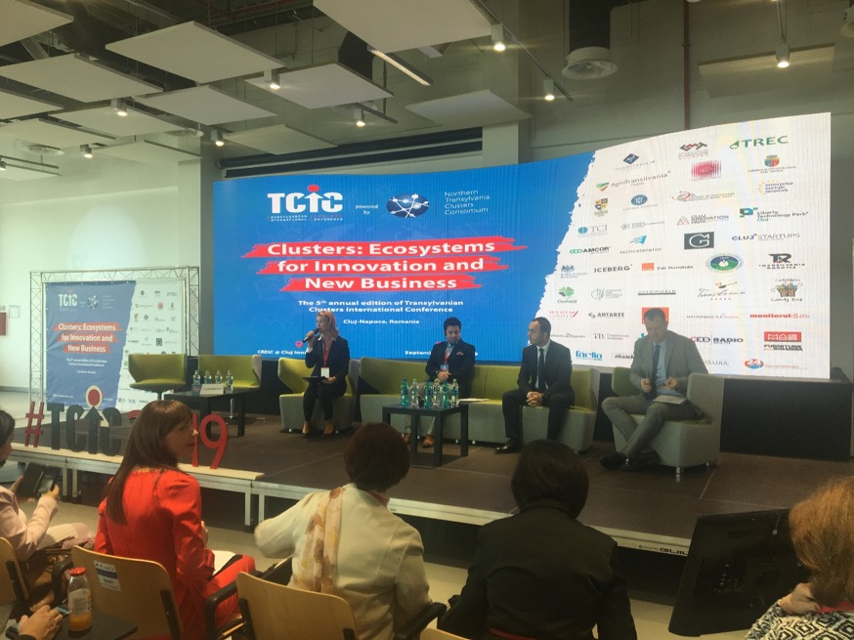
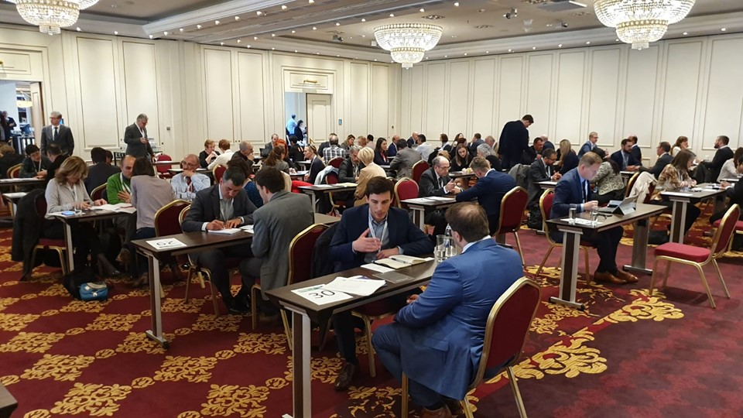
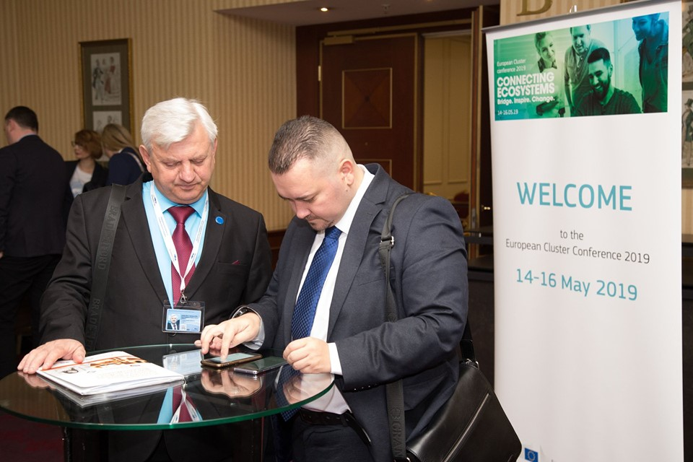
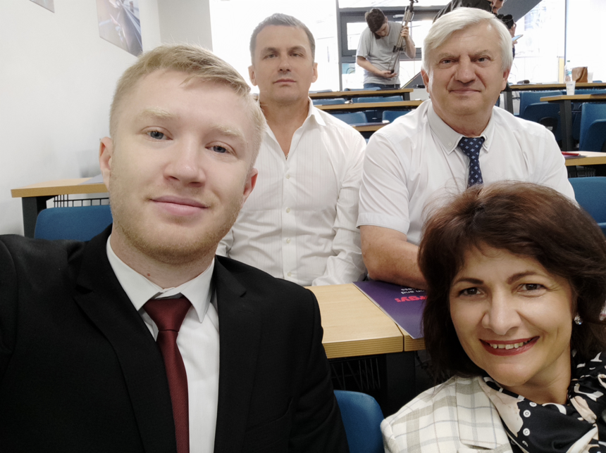
International conferences of clusters in Bucharest and Cluj-Napoca, Romania.
Cluj-Napoca, 09.2019
Bucharest, 05.2019
Bucharest, 05.2019

Slide 10
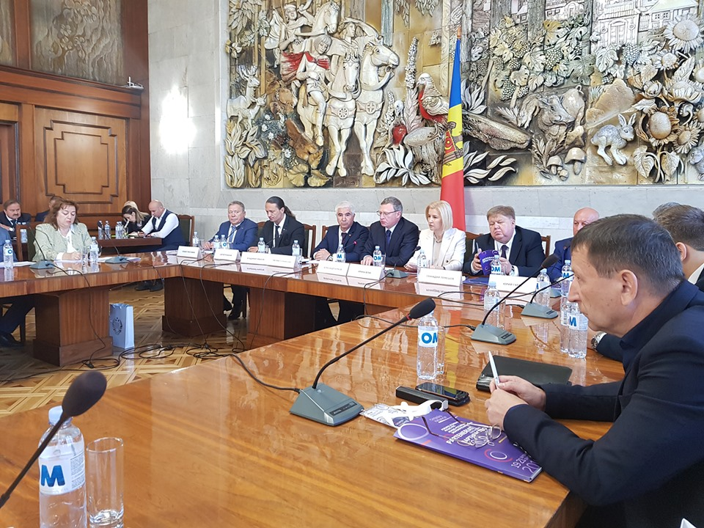
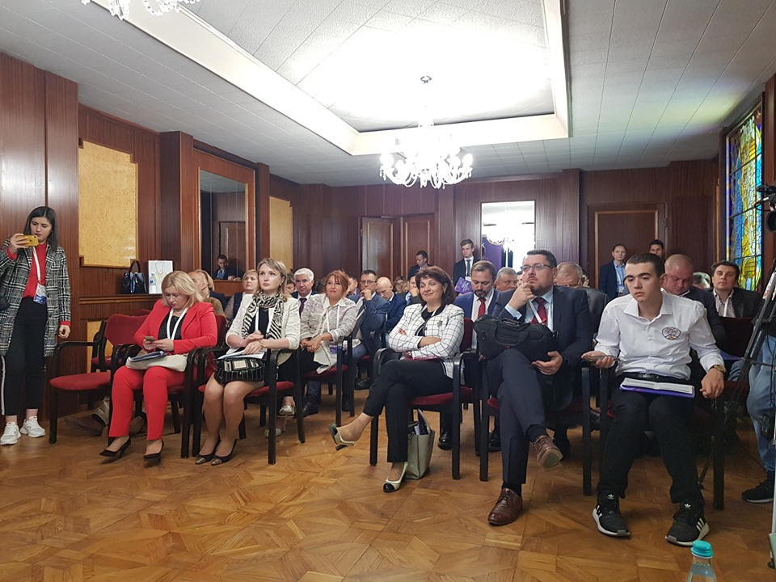
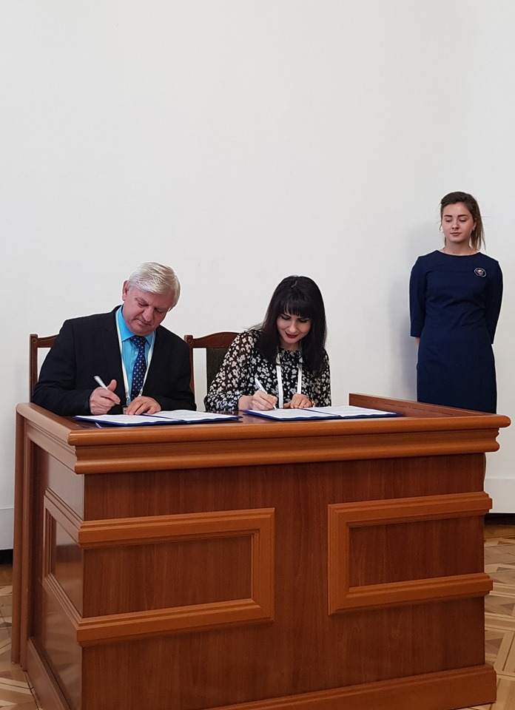
Moldovan-Russian Forum, 20.09.2019, Palace of the Republic, Chisinau.
"Development of regions" section.
Signing the collaboration contract.
Section "Development of clusters in Moldova and Russia".
Cluster Consalting Group, Penza, Russia.

Slide 11
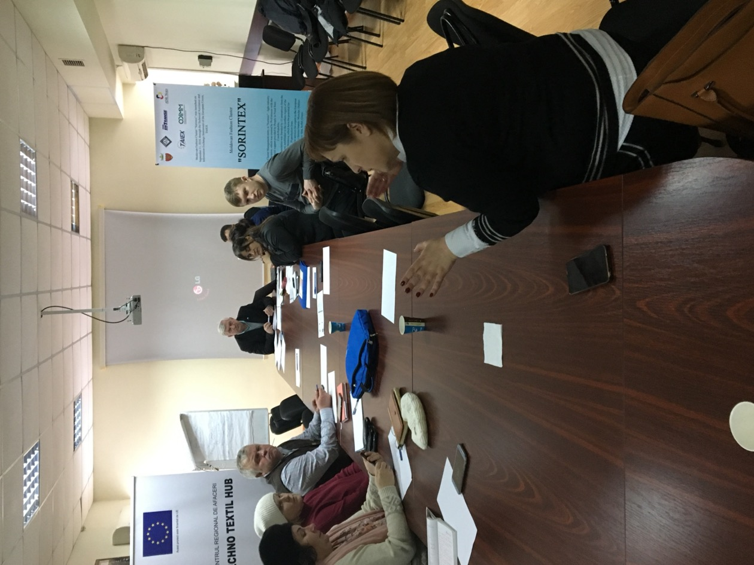
Elaboration of the development strategy of «Sorintex»
25.01.2019
SES Germany project
Development strategy
Professions and technologies.
Trade and sales.
Education and innovation.
Small and medium business.
Educational institutions that provide professional training.

Slide 12
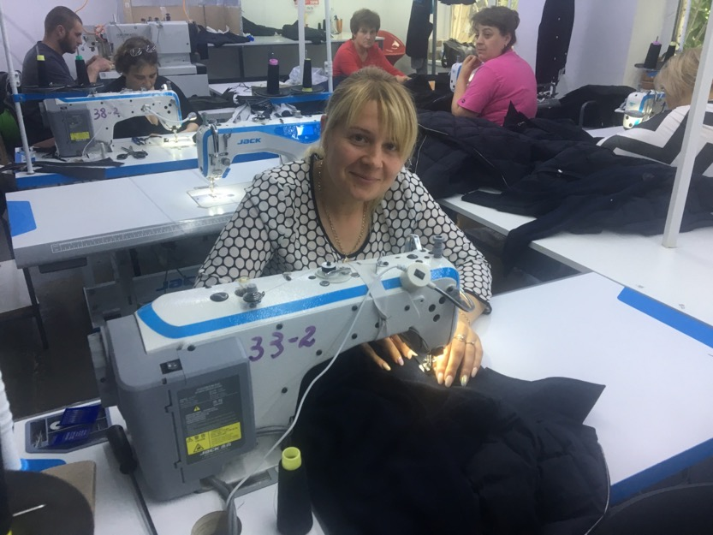
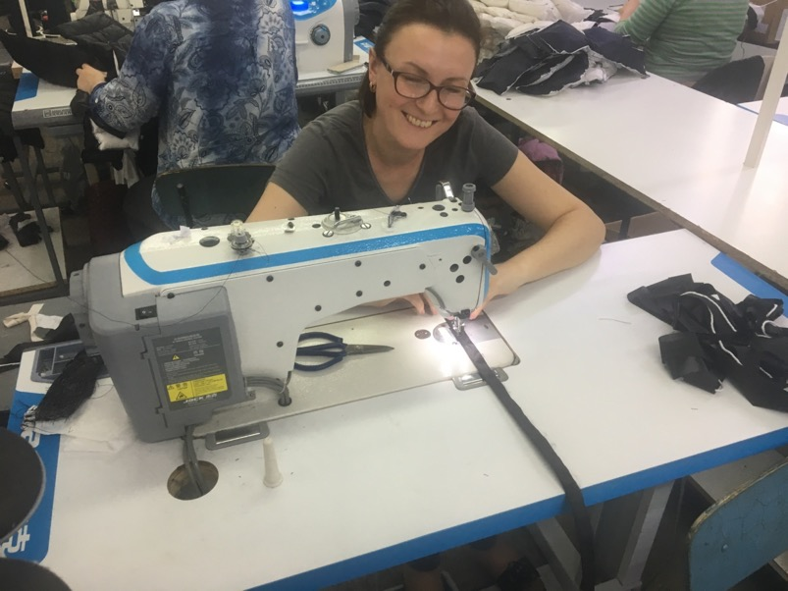
Purchases of common equipment, required for associate members. TOTAL 40 000 euro.

Slide 13
2. The strategic objective is to strengthen the cooperation between the members of the cluster.
Activities | Results
1. Organization of working groups between cluster members. | 1. The number of working groups.
2. Organization of networking activities between cluster members. | 2. The number of documentary contacts between cluster members.
3. Access to third-party funding sources for cluster members. | 3. The number of implemented projects.
4. Sharing information between cluster members. | 4. Number of seminars, workshops, newsletter for associated members.
5. Identifying and facilitating business opportunities for members. | 5. Number of relevant information distributed.
6. Organization of specific training sessions for Members. | 6. Number of organized sessions.

Slide 14
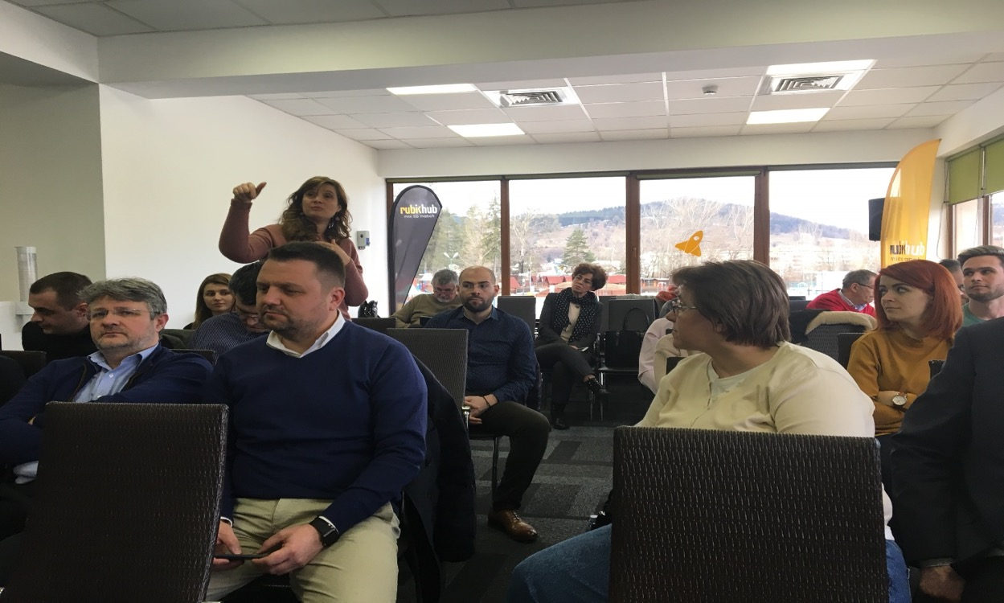
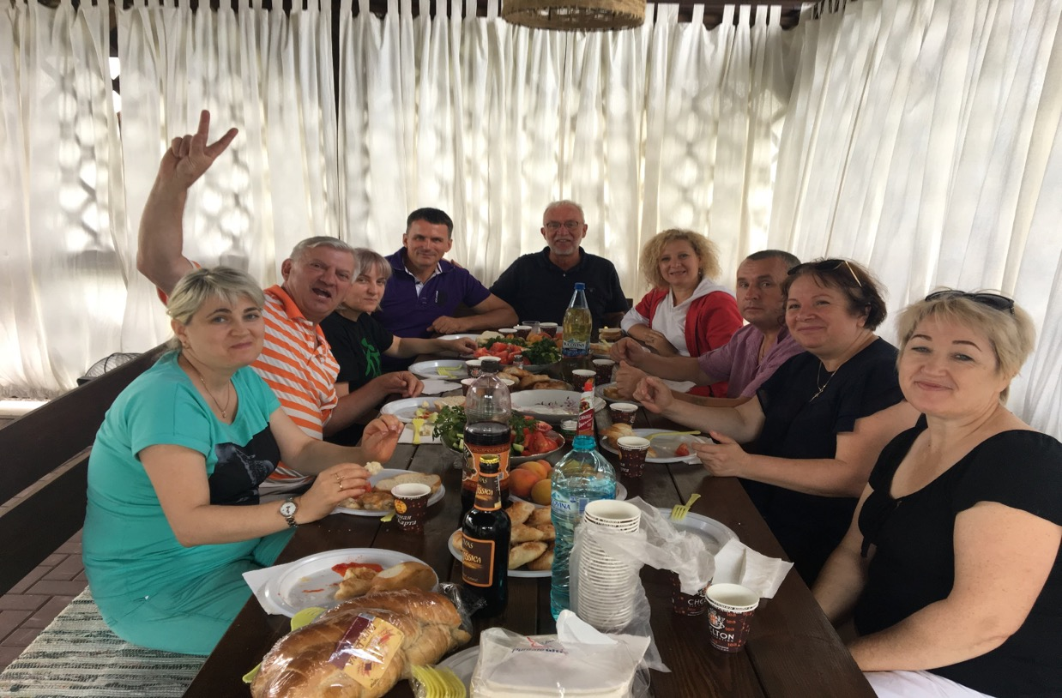
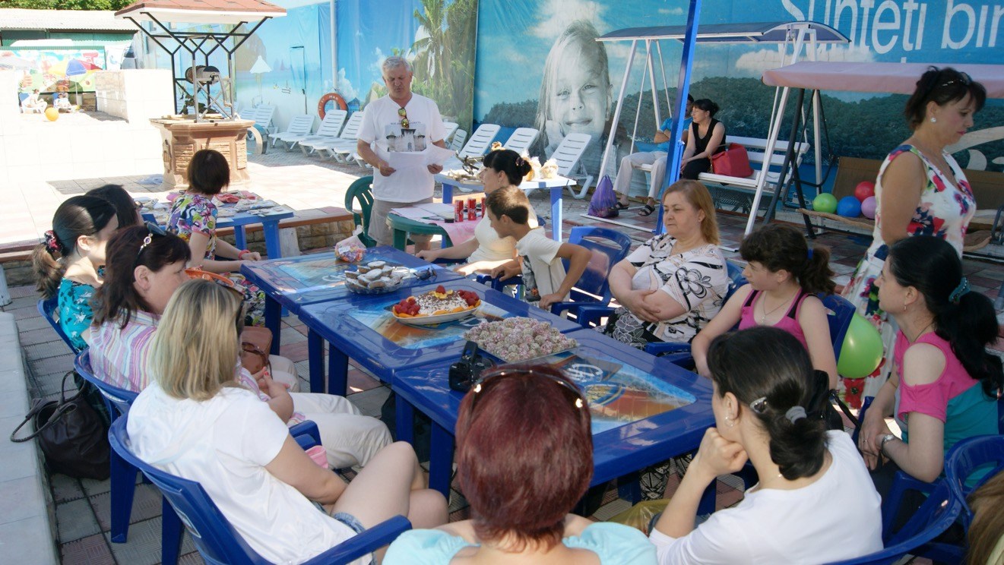
Team building activities and informal meetings of association members.

Slide 15
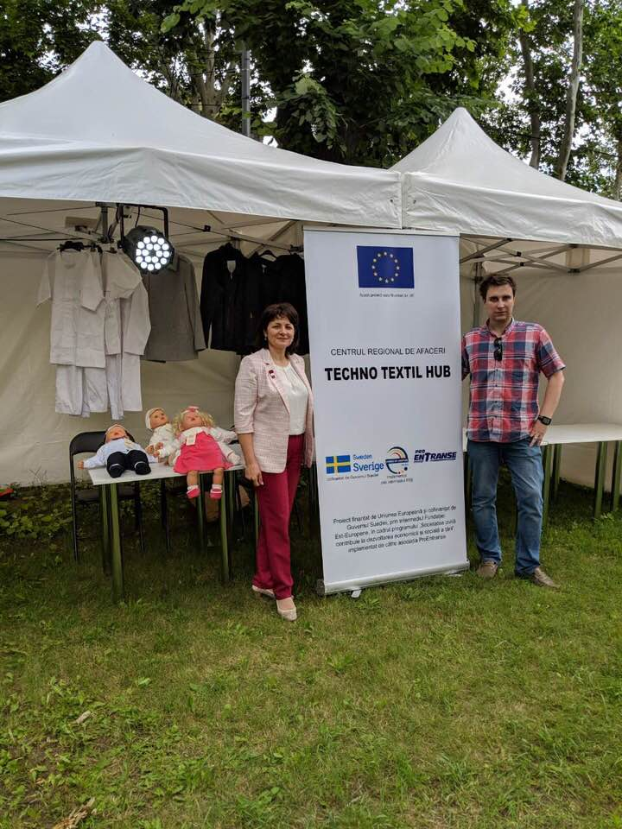
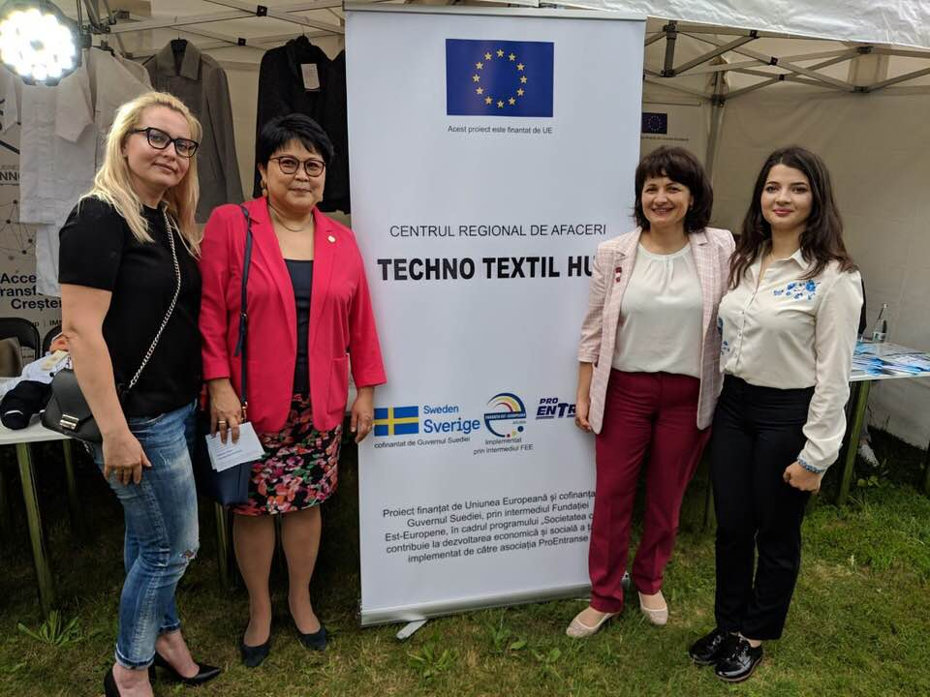
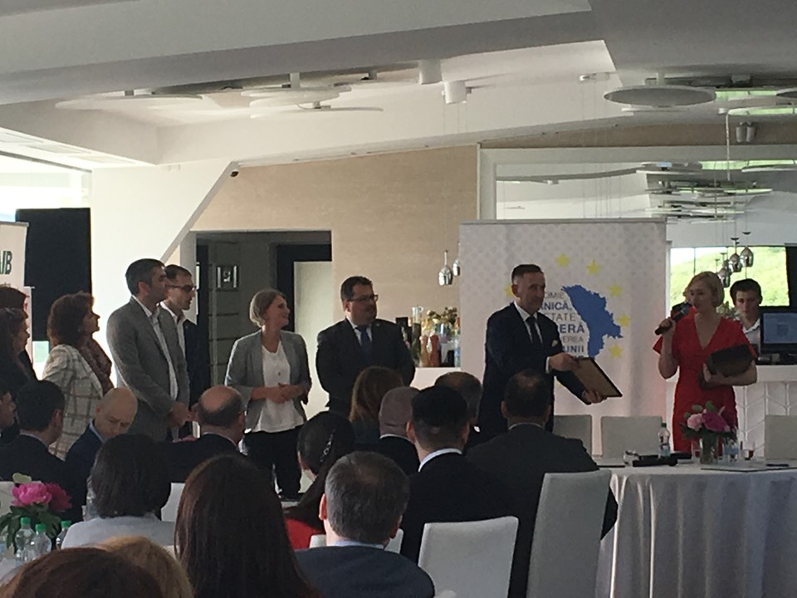
The Techno Textil Hub Soroca business center - the Sorintex catalyst.
Signing of the memorandum of the European Regional Business Platform - ТTH

Slide 16
3. The strategic objective - increasing the internationalization and export capacity of the cluster and its members..
Activities | Results
1. Organization of visits for the exchange of good practices. | 1. Number of visits of some clusters from abroad and visits of the cluster to other clusters.
2. Participation in international fairs and conferences. | 2. Number of participations in fairs and conferences.
3. Organization of economic missions. | 3. Number of economic missions.
4. Market studies. | 4. Number of market studies developed.
5. International matchmaking activities. | 5. Number of matchmaking activities spent.
6. Participation in international cooperation projects. | 6. Number of international projects with the participation of cluster members.

Slide 17
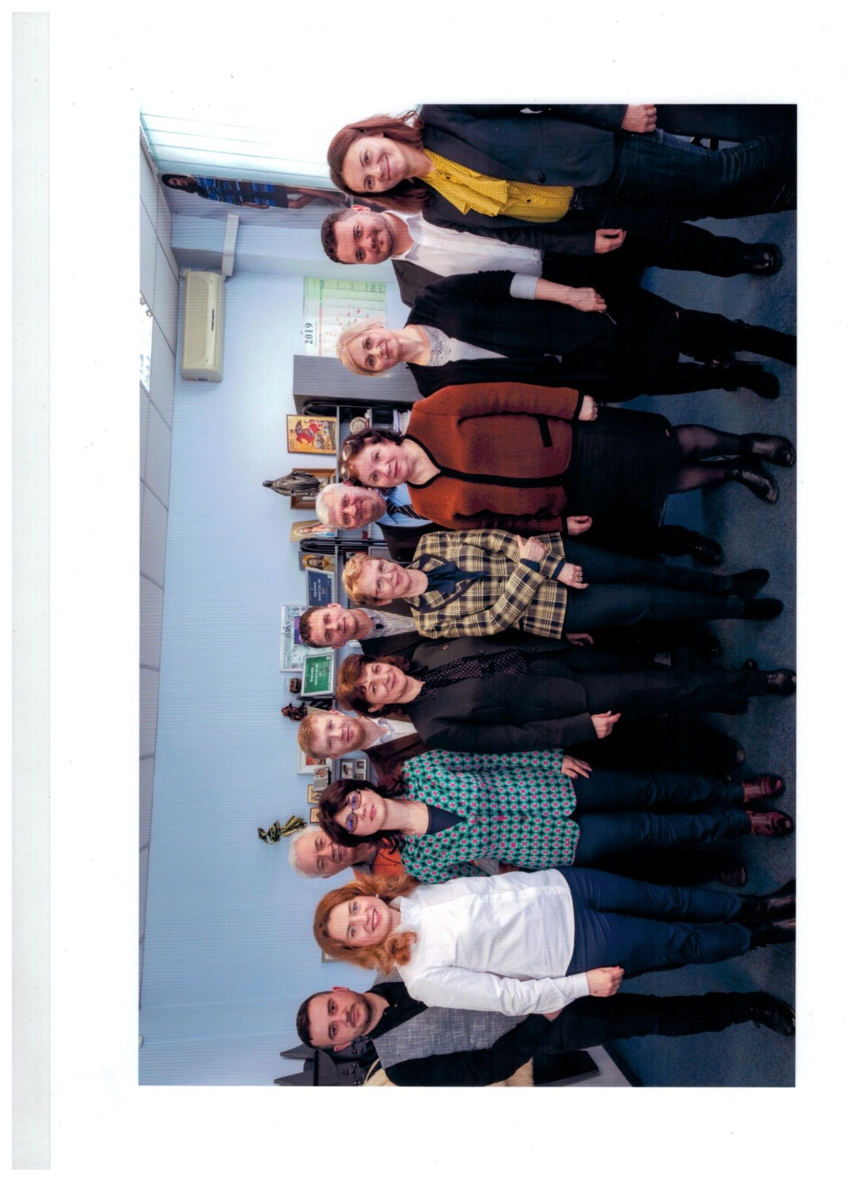
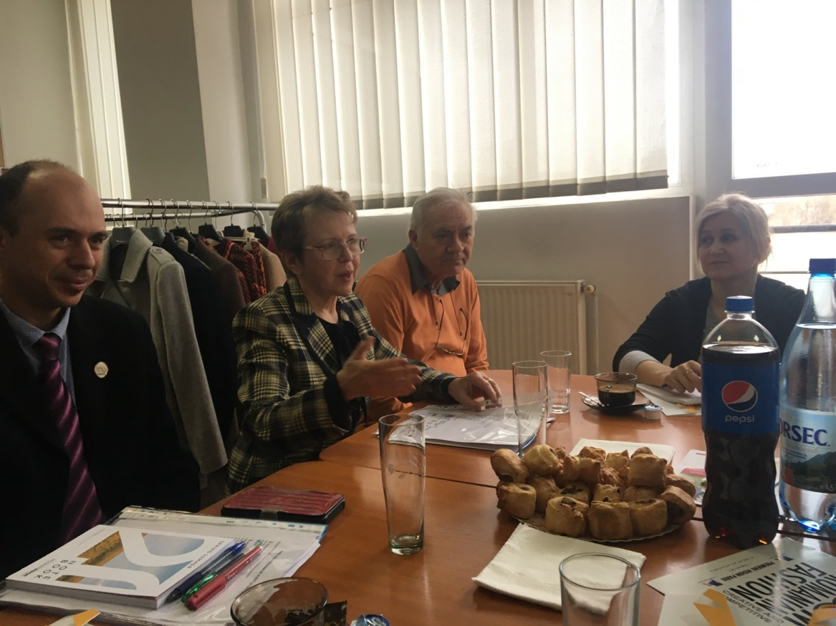
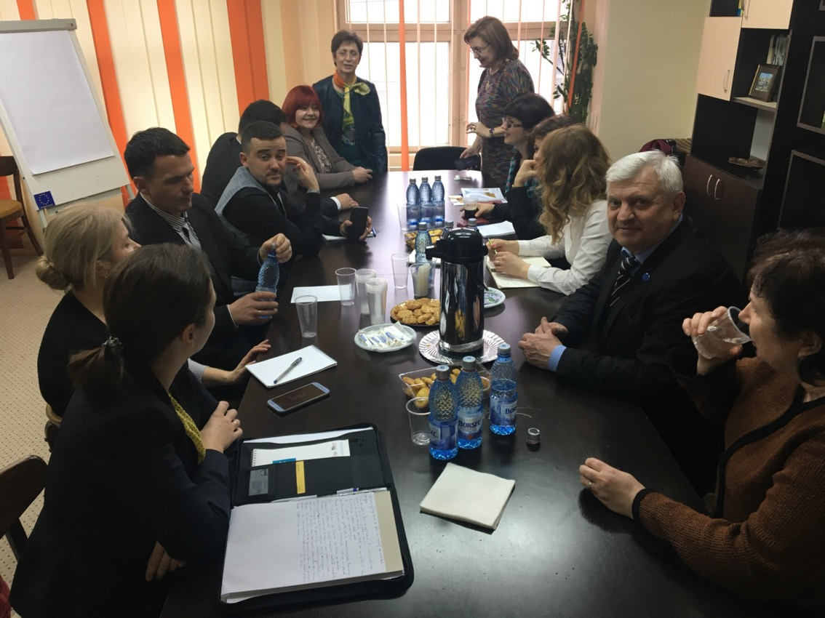
International matchmaking activities:
Iasi Technical University
Cristian ABC Iasi
EBA Chisinau

Slide 18
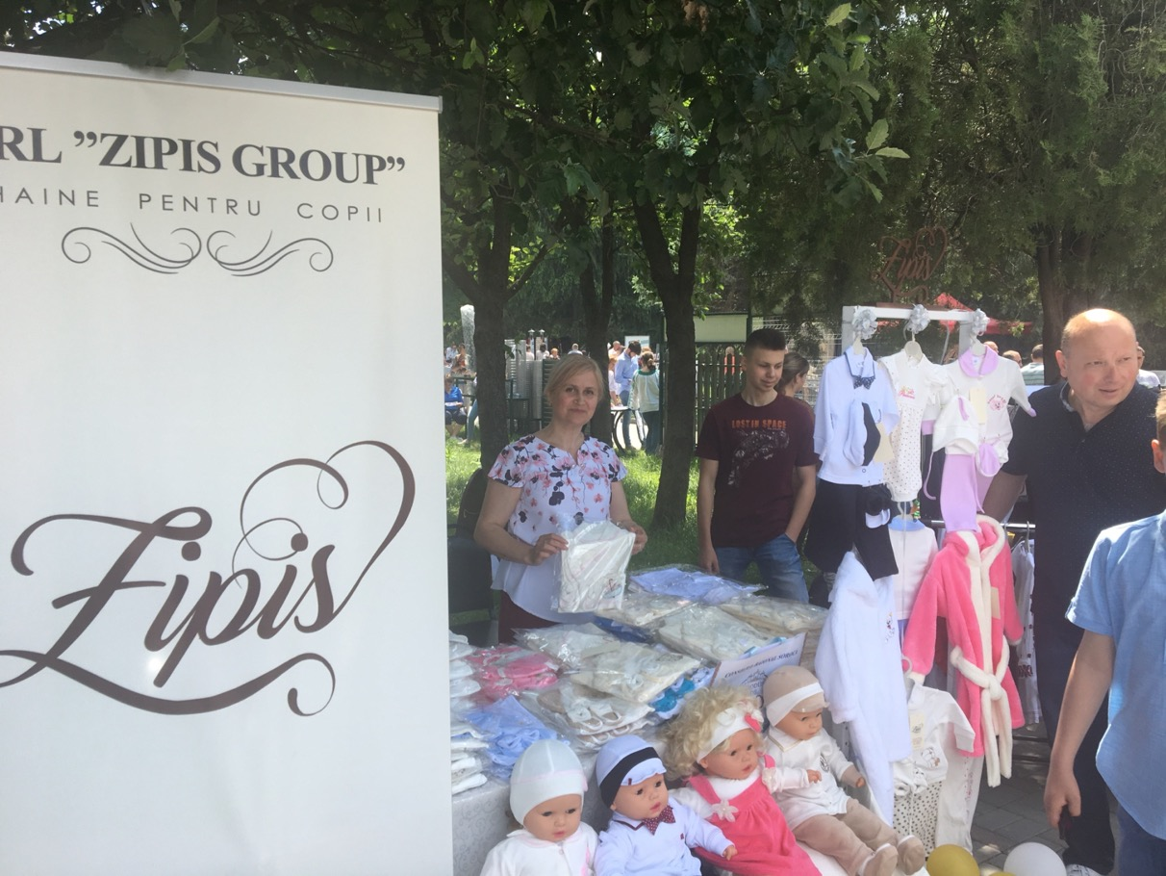
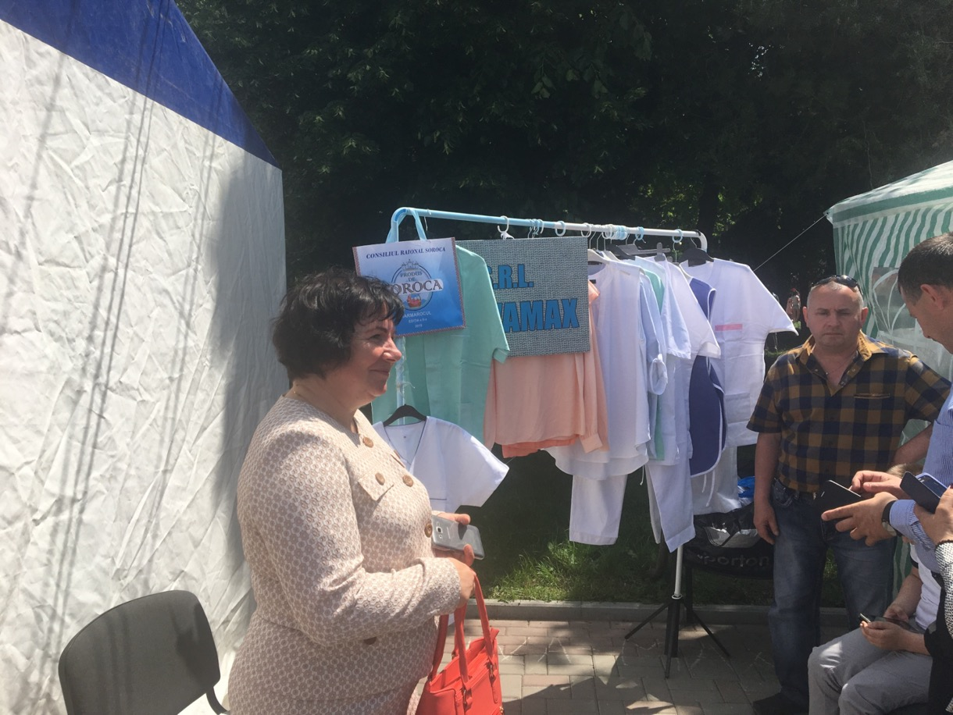
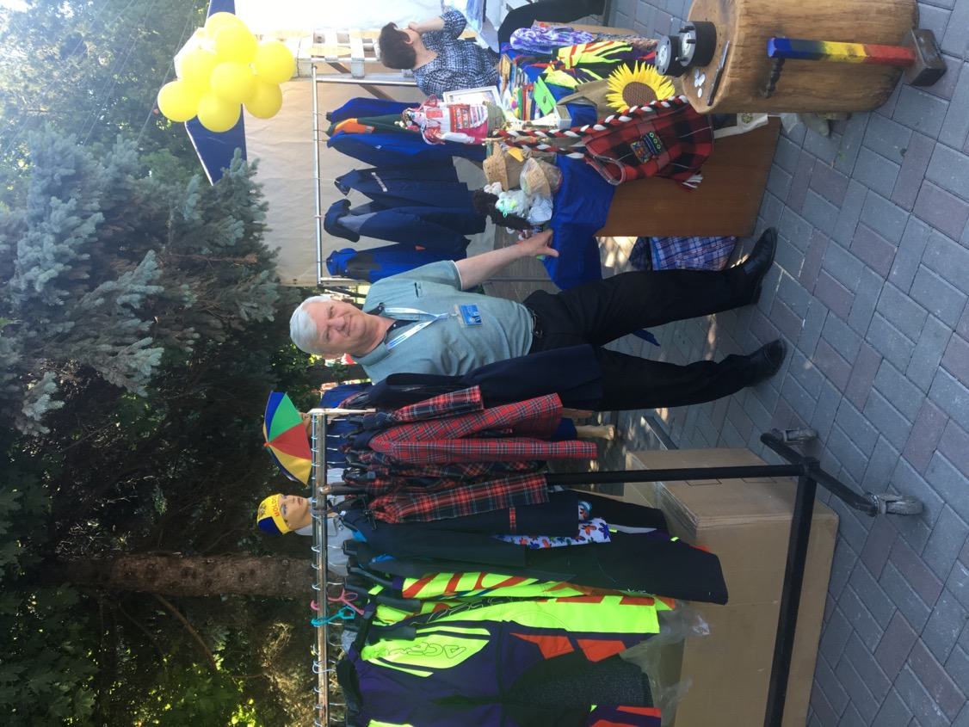
Exhibition "PRODUCED BY SOROCA" Second Edition 2019
“ Chivamax” s.r.l.
“ Zipis Group”s.r.l.
“ Bevera Nord” s.r.l.

Slide 19
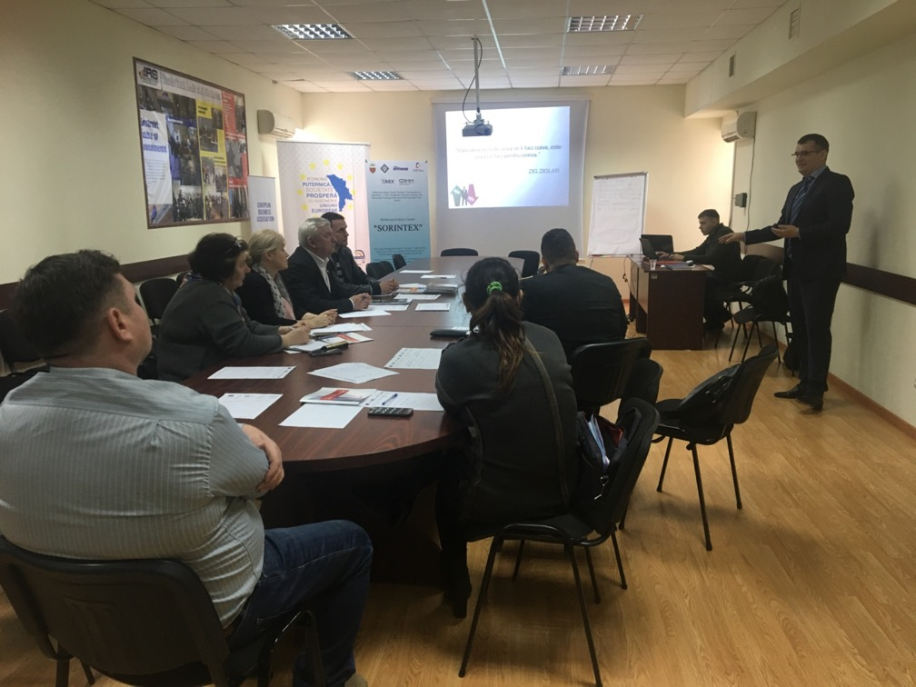
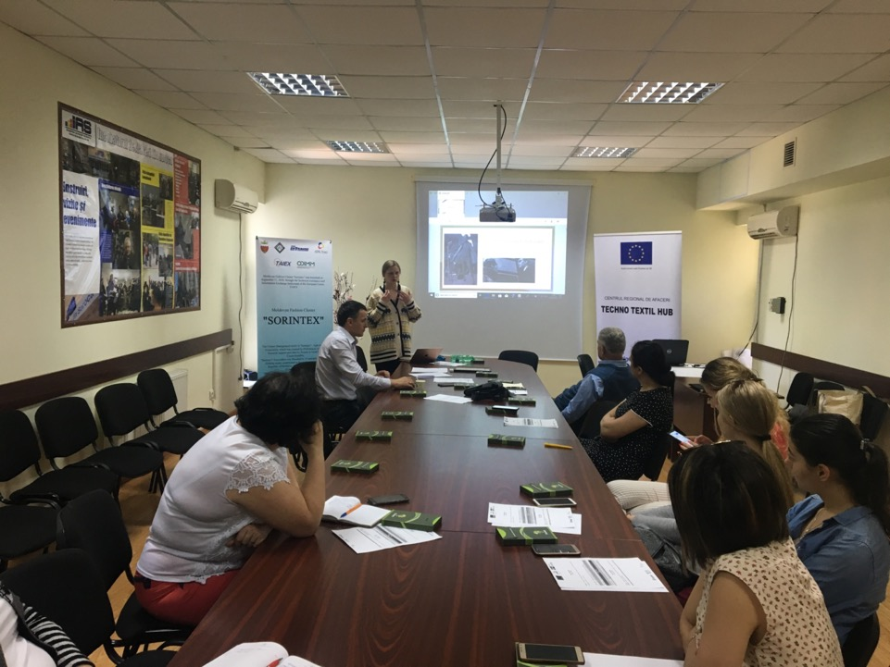
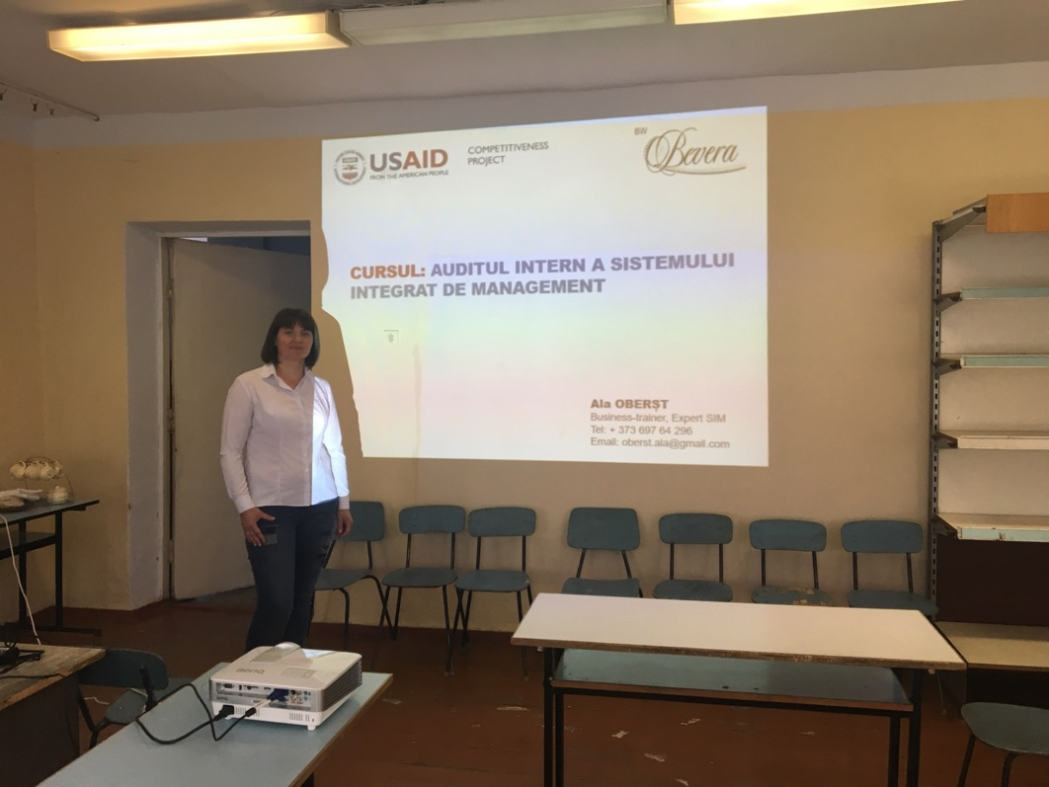
Trainings, workshops, organized in TTH Soroca
Sales and negotiation techniques. D. Nutiu
ZIP Hause, Elizaveta Senatorova.
Chemonix USAID, Ala Oberst.

Slide 20
4. The strategic objective - strengthening the collaboration between industry and school in order to increase the quantity and quality of the workforce.
Activities | Results
1. Organization of the Center of Excellence and Training of the "Sorintex" Association | 1. Number of internship sessions.
2. Curriculum development for vocational education/university courses. | 2. Number of developed curricula.
3. Conducting specific training sessions for employees. | 3. Number of training sessions for employees.
4. Promotion of dual education. | 4. Dual education programs developed and approved.

Slide 21
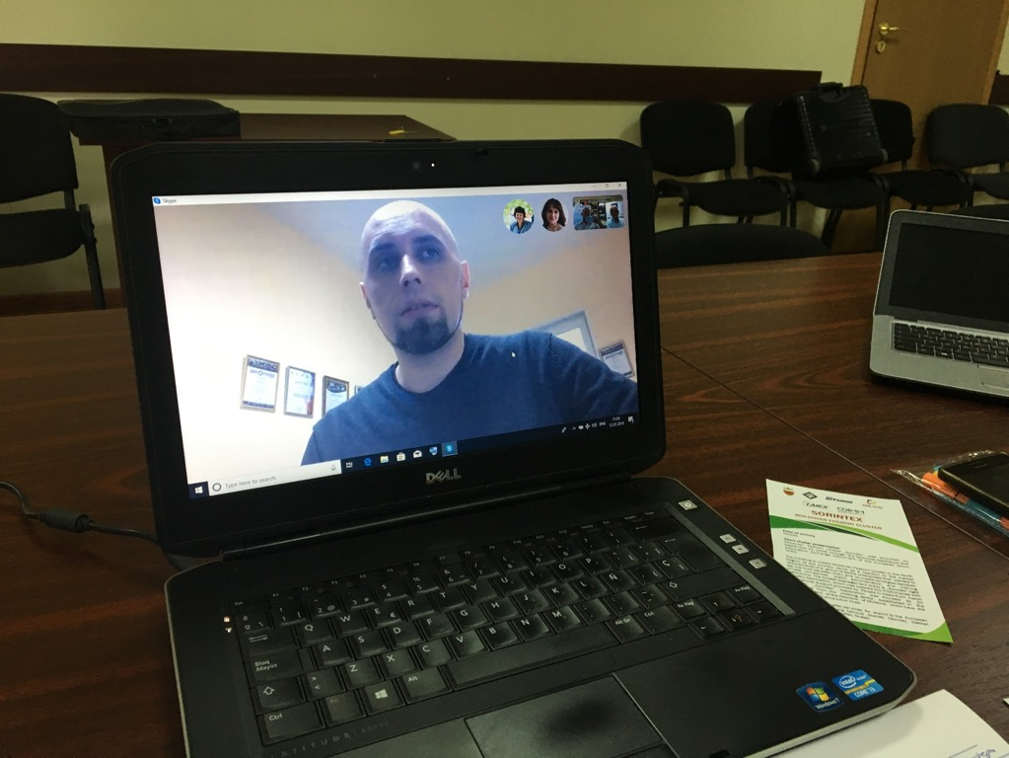
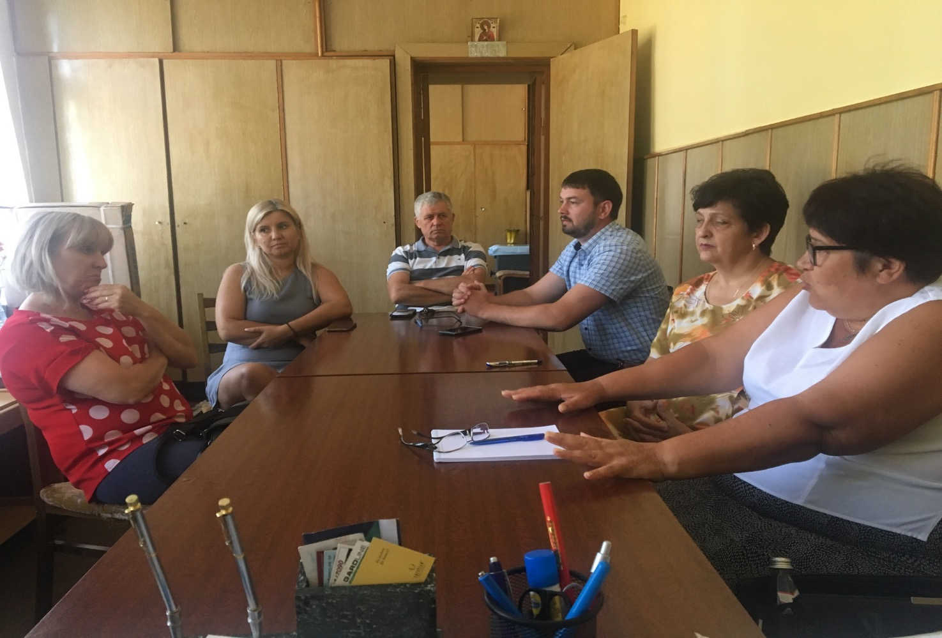
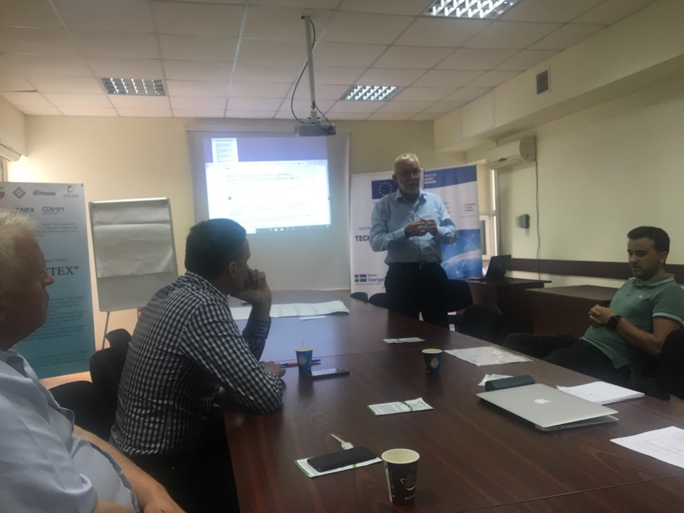
Experience exchange activities :
Video skype conferinta Murmansk-Penza.
Project SES Germania
Professional training center project.

Slide 22
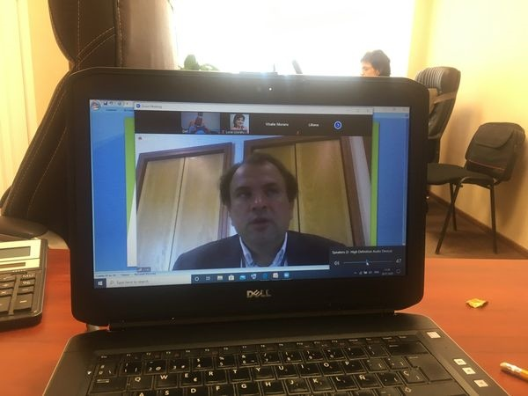
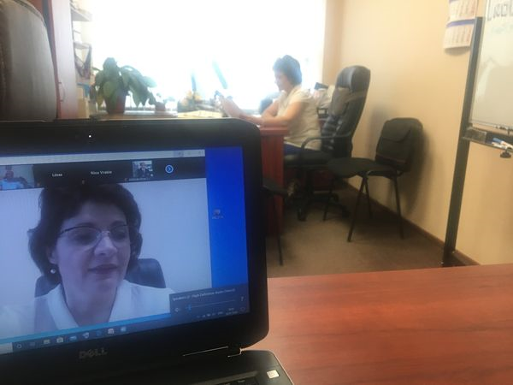
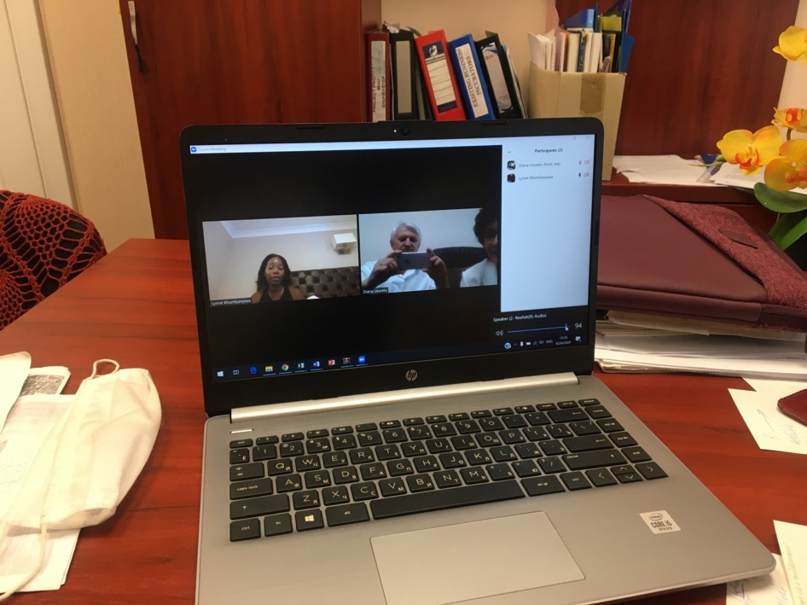
Online Video Conferences :
Lithuania
Great Britain
Spain

Slide 23
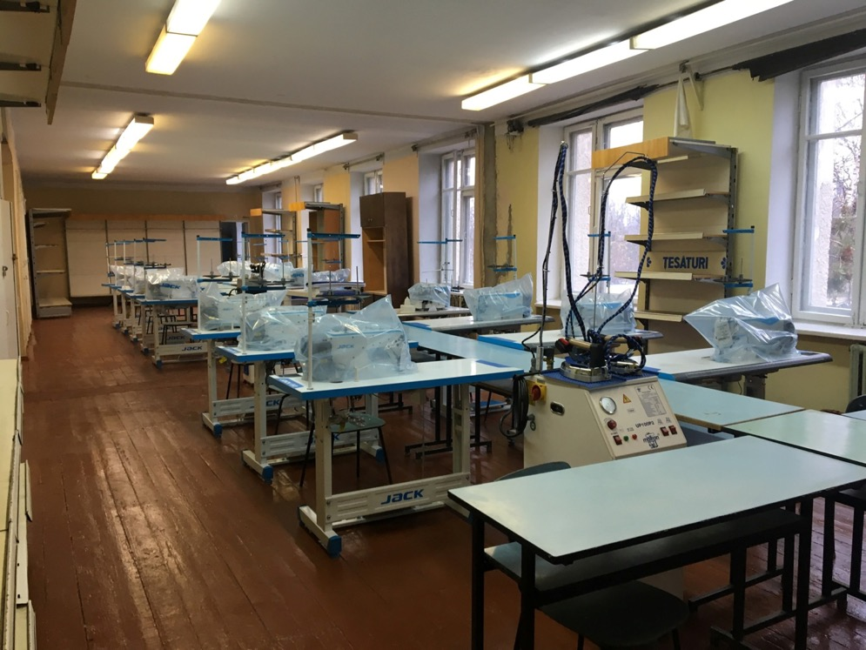
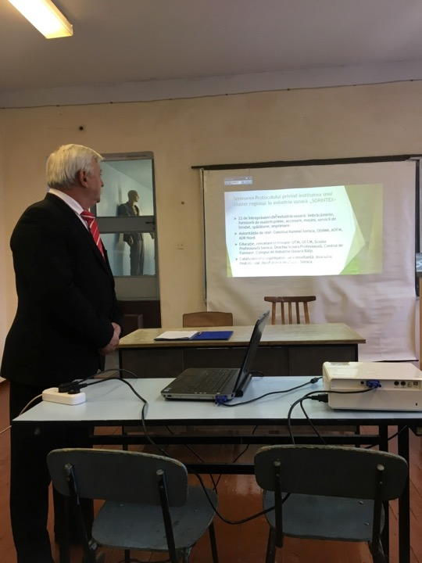
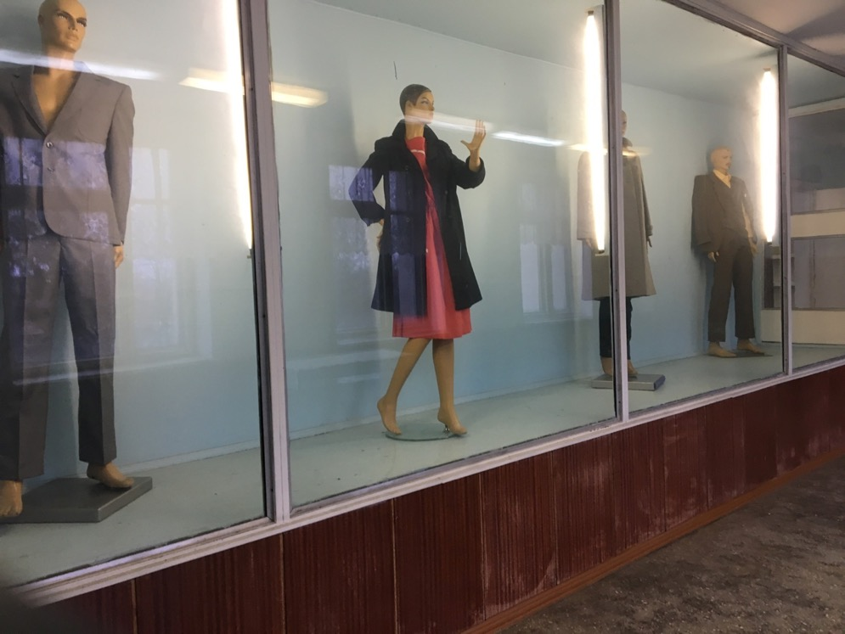
Center of Excellence and Training in light industry.

Slide 24
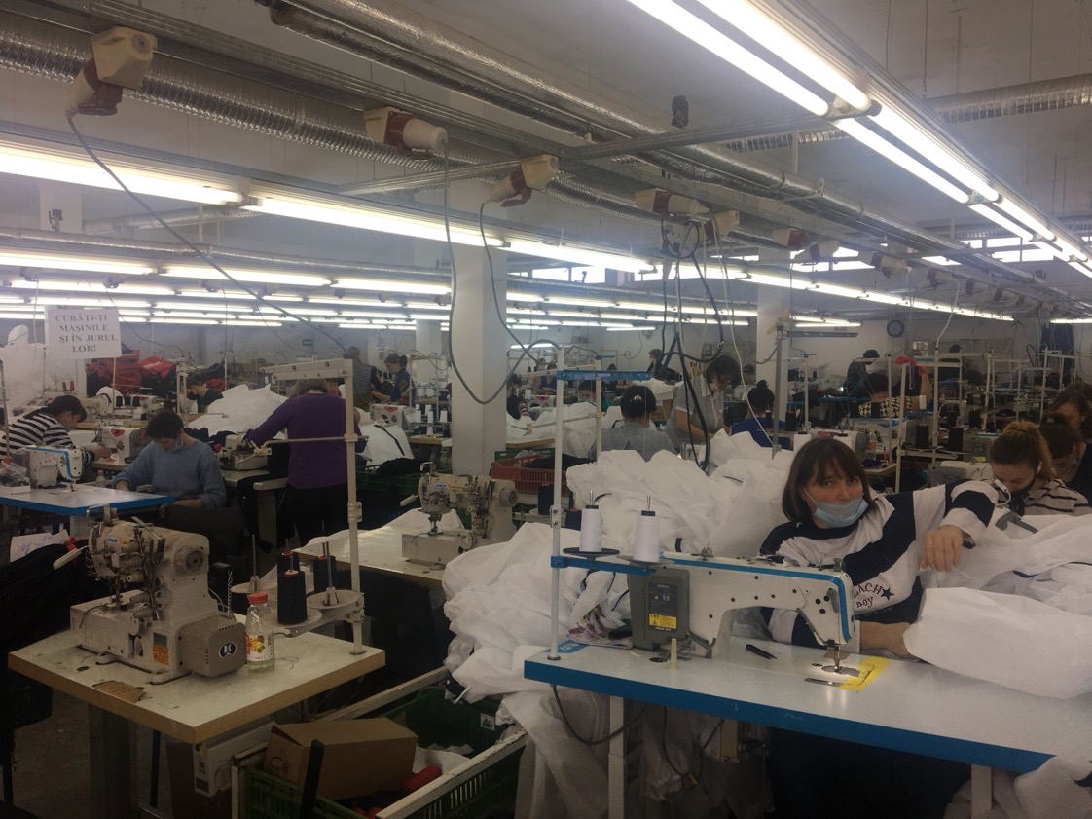
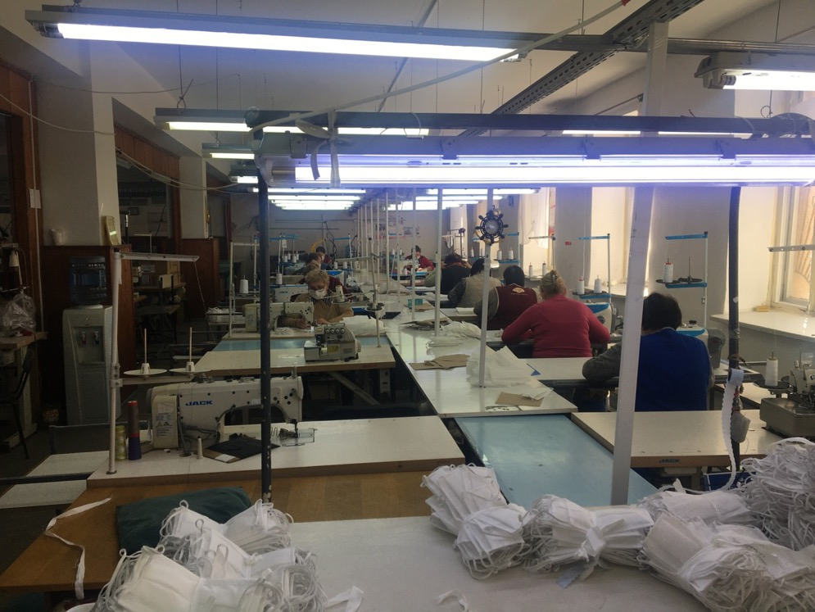
SORINTEX - mobilizer in the production of protective masks and coveralls in the fight against the consequences of COVID 19.

Slide 25
The meeting with the President of the Republic of Moldova I. Dodon and the debate on the opportunities to support the light industry sector.

Slide 26
Design and Construction Center within the Techno Textil Hub Soroca.

Slide 27
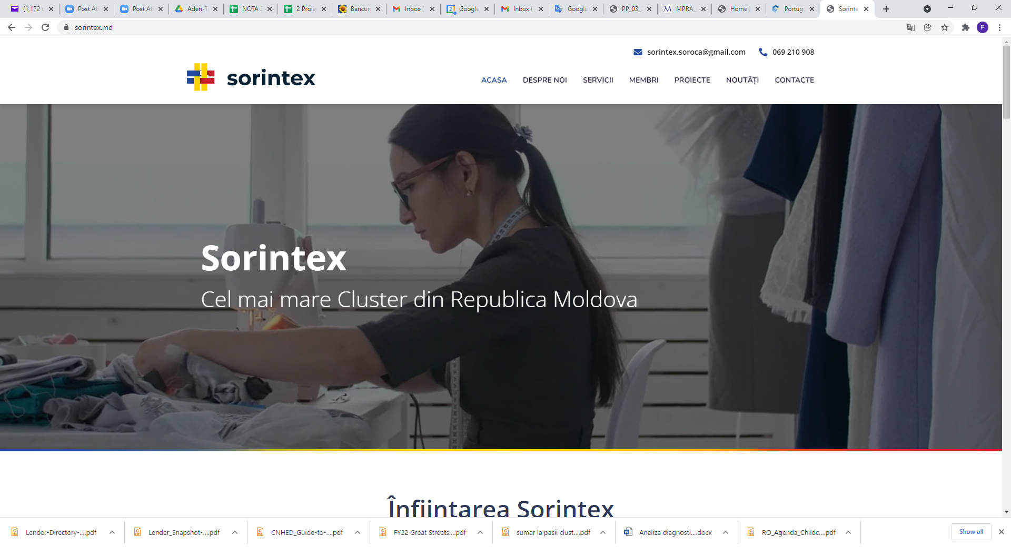
Development of a website of the "Sorintex" Association www.sorintex.md

Slide 28
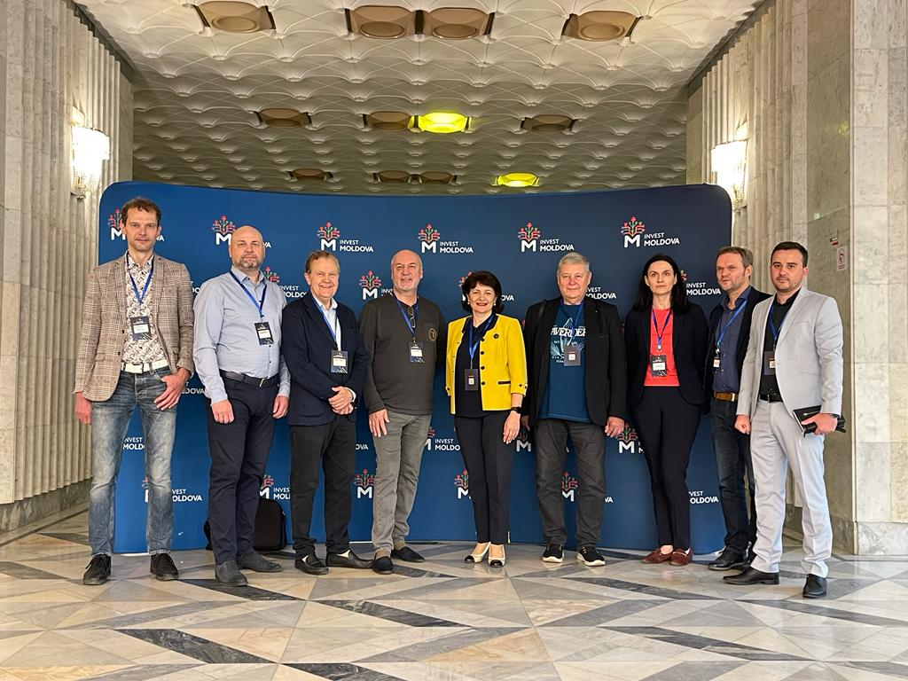
Activities carried out
Completed projects:
TTH – LAB digitization of services
The lobby and advocacy platform through smart hub
Activity with Innovation Center Lithuania September 21 in Vilnius
November 21 in Chisinau
Euro Chamber 2022
Exchange of experience between Moldavian - Lithuanian companies
Innovation center
B2B in cooperation with RTTM

Slide 29
Moving Plastics and machine industry towards Circularity. Plan-C project
About the project
Project duration: 01.01. 2024 - 30.06 2026;
Mission: "Transformation of the PLASTICS and MACHINE INDUSTRY into a circular economy, using a design thinking methodology";
Project consortium, consisting of 14 partners from DE, AT, CZ, SK, HU, RS, BiH, RO, and MD;
Budjet for SORINTEX (Republic of Moldova):
92 000 EUR (18 400 co-financing)

Slide 30
The member companies of the "Sorintex" Cluster are interested in establishing new long-term partnerships with other European clusters, fashion clothing companies, participating in international cooperation projects, implementing innovations and transferring modern technologies, they will also contribute to increasing the number of jobs and the supply of social capital for national small and medium-sized enterprises (SMEs)
Interest in cooperation

Slide 31
Thank you for your attention!
Andrei MiRZA
President of the Association of Enterprises from Light Industry "SORINTEX„
Contacts: R. Moldova, City Soroca,
str. Vasile Stroiescu, 50, tel. +373-69210908,
e-mail sorintex.soroca@gmail.com,
www.sorintex.md

